Slide 1
Being a Managing Director
EIT Digital Master School @Eötvös Lorand University
Business Development Lab

Slide 2
Legally founding a company
Most relevant forms for start ups are
limited liability companies or
stock companies (first private, then publicly offered stocks)
Related legal framing strongly depends on national law
2

Slide 3
Example from Germany: GmbH
Limited liability company in Germany: GmbH (Gesellschaft mit beschränkter Haftung)
Legal bodies: Management Board, Shareholders Assembly; possible: Supervisory board
Minimum capital: 25,000 Euros (stock company: 50,000 Euros)
Shareholders contract similar to “statutes” or “rules of procedure”
3

Slide 4
Example from Germany: GmbH
Shareholders contract containts (for example):
§1 Legal form, company seat, fiscal year
§2 Purpose
§3 Mandatory publications (e.g. annual accounts)
§4 Nominal capital (shares)
§5 Legal bodies
§6 Management Board (number, appointment, dismissal, duties)
§7 Chairman of the Shareholders Assembly (supervisory board optional)
§8 Shareholders Assembly (duties, votings, e.g. discharge of management)
§9 Annual Accounts
§10 Liabilities
§11 Disposal over shares, sales and acquisition of shares
§12 Notice and termination
§13 Final provisions
4

Slide 5
Management Board
If there is only one managing director: CEO, otherwise the individual rights and votings have to be explicitly laid down)
By-Laws can contain further regulations which do not have to be registered at the magistrate’s court (including notary involvement)
Typical duties: to represent the company outside and inside, report to shareholders assembly, create the annual economic plan, create the annual accounts, run the business with due diligence, obey the law and the shareholders decisions, decide within the duties of consent with the shareholders.
5

Slide 6
Management Board
Economic plan (example)
Cash Flow Plan (income, expenses)
Investment Plan
HR Positions Plan
Profit & Losses (Plan P&L)
6

Slide 7
Founders Dilemma
EIT Digital Master School @Eötvös Lorand University
Business Development Lab
Inspired by Noam Wasserman “The founder’s
DILEMMA” Harvard Business Review Feb 2008

Slide 8

8

Slide 9
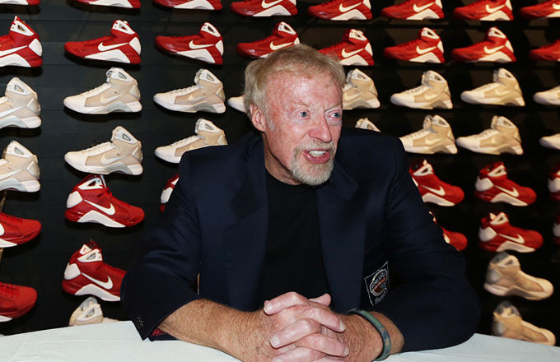
Phil Knight

Slide 10
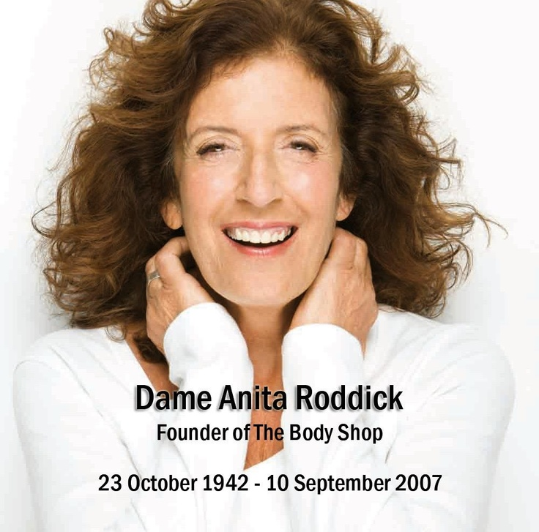
10

Slide 11
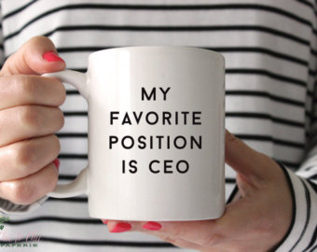
Everybody wants to be CEO
Each of them founded a large company
Staying CEO for many years
Successful CEO-cum-founders are rare
Year 3 venture: 50% no longer CEO
Year 4: only 40%
IPO: fewer than 25%
* Survey on 212 American startUps between 90’s and 2000s
11

Slide 12

Founders don’t let go easily
Entrepreneurs are forced to step
down from the CEO’s post.
12

Slide 13


Why? Entrepreneur = Wealth
13

Slide 14
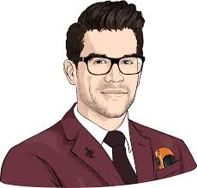
Why? They like their job
“Entrepreneurs as a class make as much money or less than employees”
American Economic Review 2002
“Entrepreneurs make 35% less over 10 years” Hamilton 2002
Higher Risk job!
14

Slide 15
Why? They like their job
“in my experience, founders often make decisions that conflict with the wealth maximization principle. Some options had the potential for generating higher financial gains but others, which founders often chose, conflicted with the desire for money.”
Noam Wasserman
Founders are not only driven by Money
But also by the dream of creating and leading the company
15

Slide 16
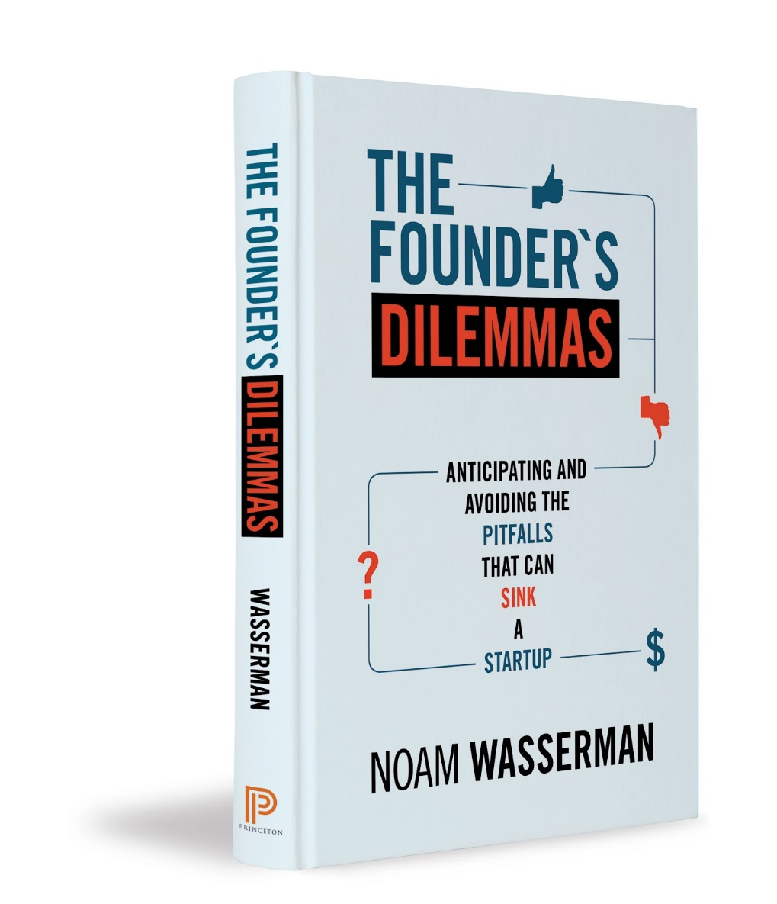
Everybody wants to be CEO
Noam Wasserman associate professor at Harvard Business School.
His HBS class, Founder’s Dilemmas, was named one of the top entrepreneurship classes in the county by Inc. magazine.
He focuses his research on early founders’ decisions and start Up dissolutions
16

Slide 17
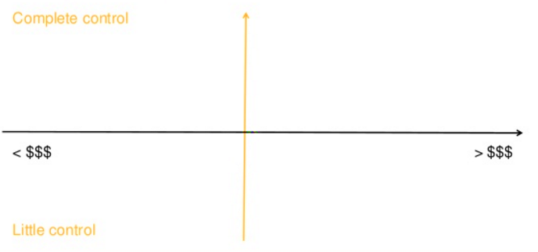
Pick your quadrant
17

Slide 18
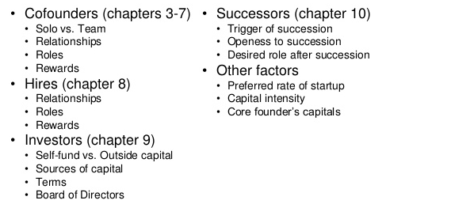
Decision to be taken
* Devoxx 2014: The Founder's Dilemmas
18

Slide 19
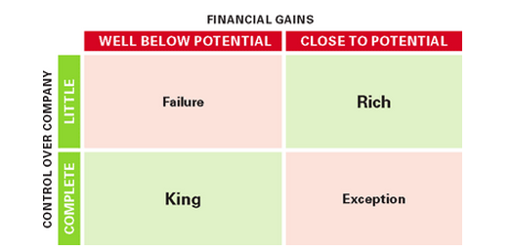
Trade-Off between King and Rich
gives up more equity to attract investors builds, has a more valuable company than one who parts with less.
motivated by control will make decisions that enable
to lead the business at the expense of increasing its value.
19

Slide 20
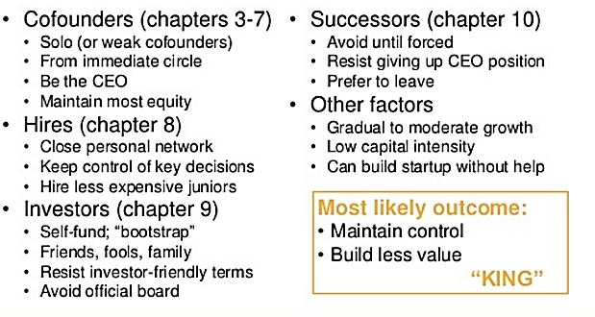
Be King
* Devoxx 2014: The Founder's Dilemmas
20

Slide 21
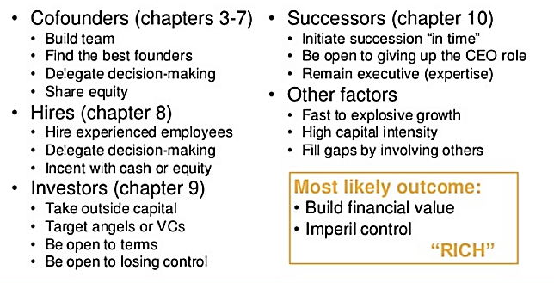
Be Rich
* Devoxx 2014: The Founder's Dilemmas
21

Slide 22
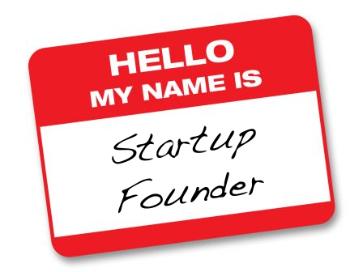
Keeping Founders on Board
What do boards do with founders after
asking them to step down as CEO?
Keep the founder involved
in some way, often as a board member,
“You can replace an
executive, but you can’t replace a founder.”
22

Slide 23

Keeping Founders on Board: bad way
Relegating the founder to a cosmetic role
This can backfire:
Founders can act as negative force
Resist changes suggested by new CEOs Encourage their loyalists to leave
23

Slide 24

Keeping Founders on Board: nice way
Help founders find new roles:
Offer him or her the luxury of focusing on an area of its affinity (Let him/her PLAY)
and letting the new CEO “take on all
the things you don’t like to do.”
24

Slide 25
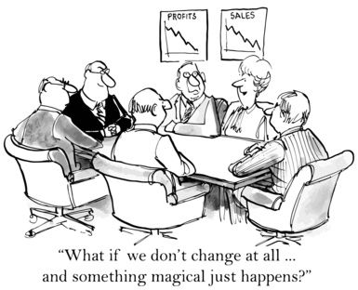
Want to stay CEO for long?
Learn new skills.
If you do, you may even become accomplished enough to regain control.
25

Slide 26

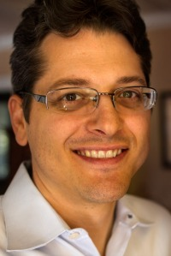
Want to stay CEO for long?
E Ink’s CEO Russ Wilcox identified skills he needed to strengthen.
He rotated through:
finance, product marketing, sales, and
even R&D to fill the gaps.
In 2004, when the board launched a
search for the company’s next CEO,
it couldn’t find anyone more qualified.
26

Slide 27
Thank you!
Brought to you by EIT Digital Master School @Eötvös Lorand University
Find me at: anna.reale@inf.elte.hu

